Slide 1


Optical failure localization
Network Measurement and Data Analysis Lab
Moein Taherinezhad - 10935476
Niloufar Sasannia - 10888547
Giulia Gerometta - 10628256
July 2024

Slide 2

Talk Outline
1. Project overview
2. Data Preprocessing
3. Data Analysis
4. Data Visualization
5. Feature Extraction
6. Feature Analysis
7. Models Training
8. Results
9. Explainable AI
10. Conclusion

Slide 3
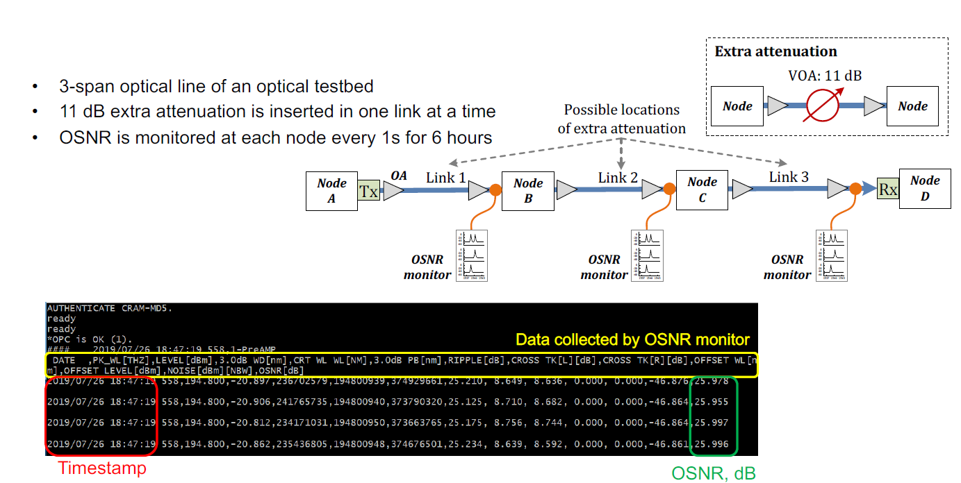
Project overview:
Type of problem: Supervised
Type of Data: Monitoring Data at each node
Feature extraction: Mean OSNR, Max OSNR, Min OSNR, Peak-to-Peak OSNR, Skewness, Kurtosis
Models: Logistic regression, XGboost, LSTM

Slide 4
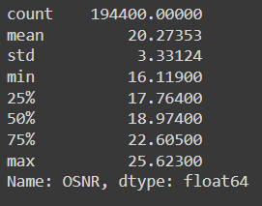
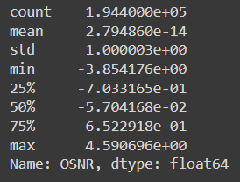
Data Preprocessing
We will import data from nine files, each containing observations from three monitors, and combine them into a single pandas dataframe. During the data loading process, we will standardize the values for each link to minimize bias and enhance our model's predictive accuracy.
Data Statistic ( Before std)
Data Statistic (After std)

Slide 5
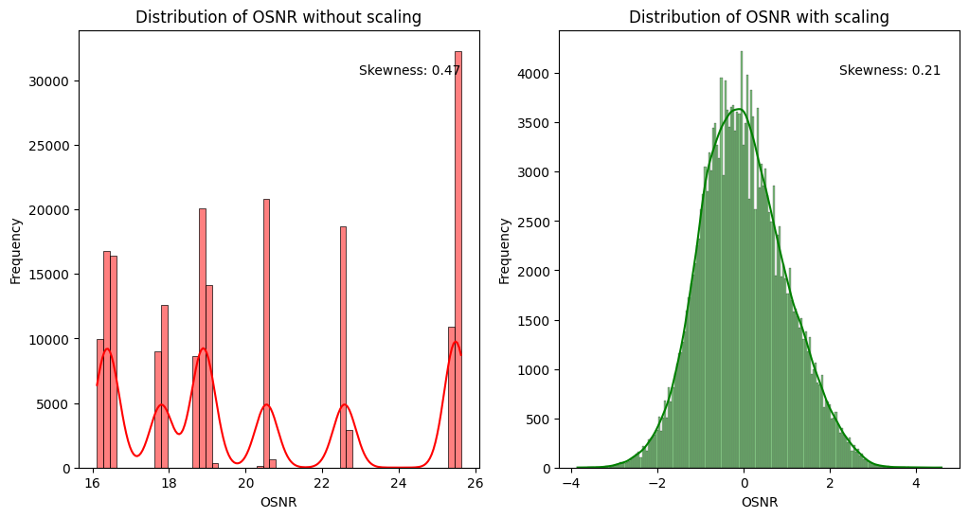
Data Visualization

Slide 6
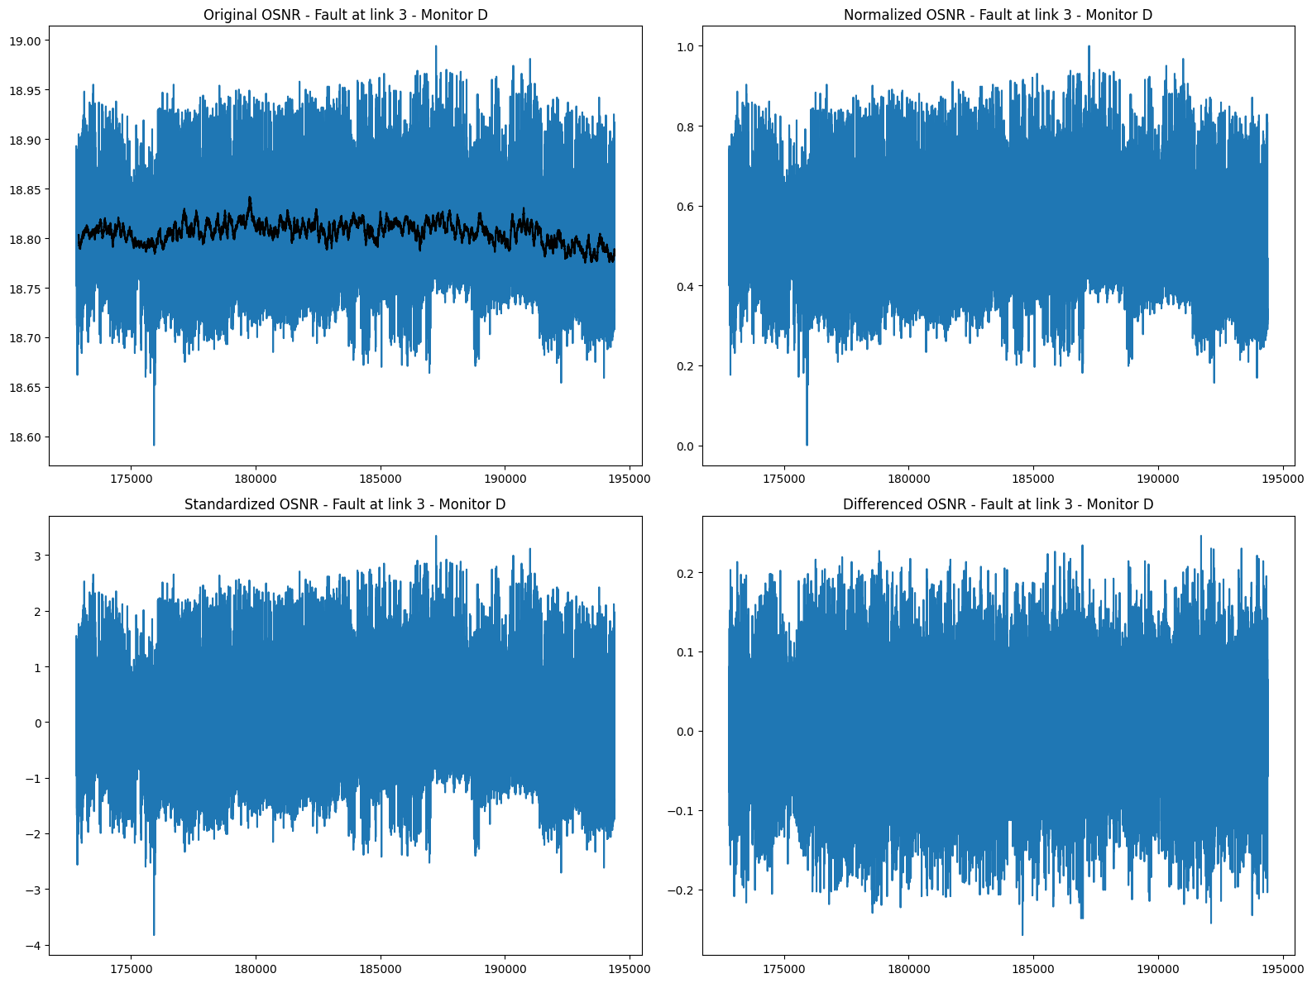
The impact of Normalization, Standardization and Differencing techniques

Slide 7
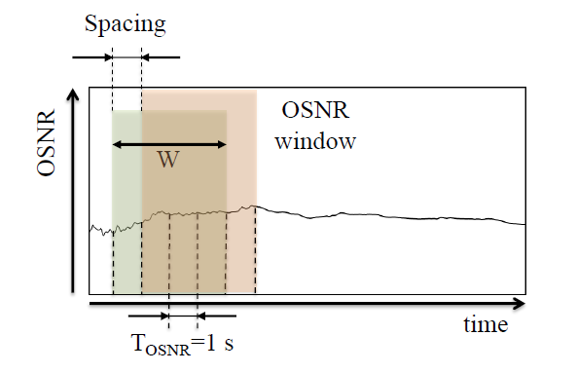
Feature Extraction
1- Mean OSNR
2- Max OSNR
3- Min OSNR
4- Peak-to-Peak OSNR
5- Skewness
6- Kurtosis
Spacing = 1s
Window = 10s
Spacing = 25s
Window = 100s

Slide 8
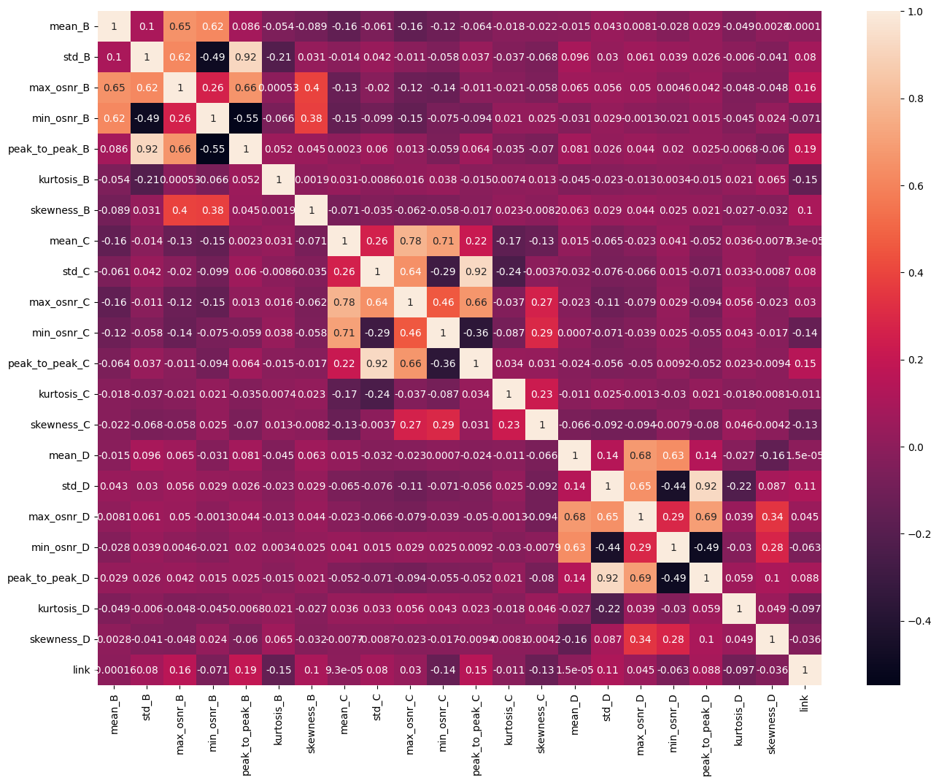
Feature Analysis

Slide 9
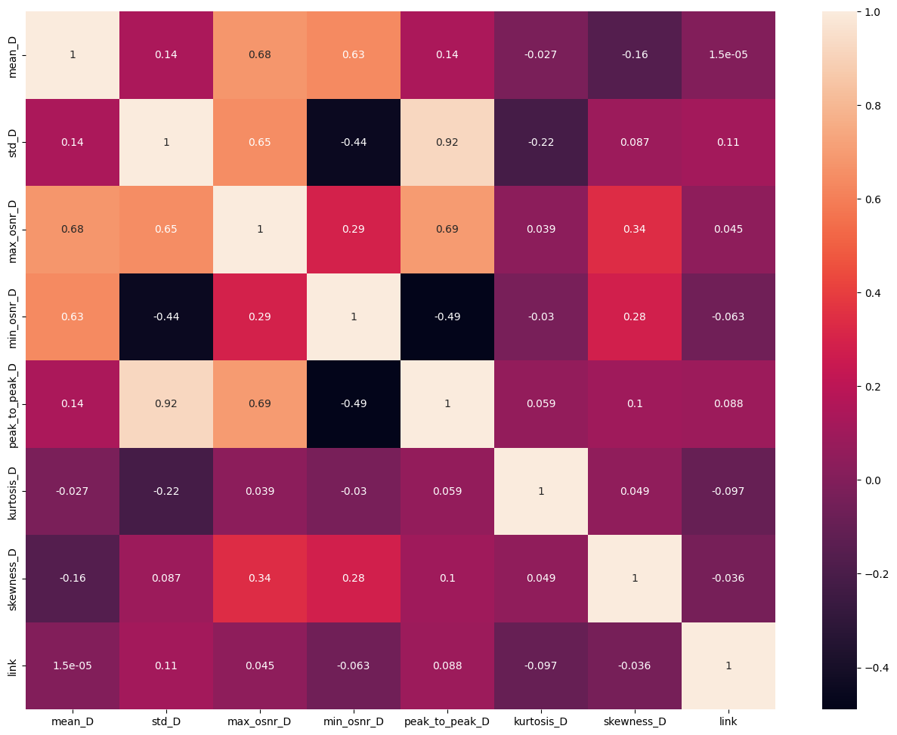
Feature Analysis – Heatmap for node D

Slide 10
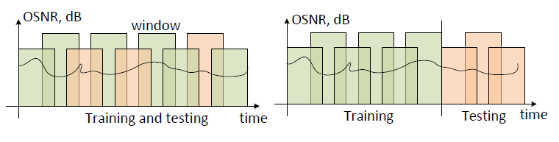
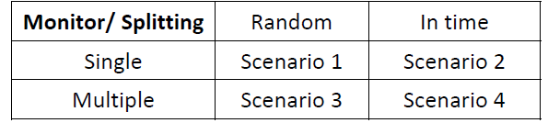
Model Training
There are 4 scenarios:

Slide 11
Model Training
Approaches:
Machine Learning Models:
1- Logistic Regression
2- XGBoost
3- Long-Short-Term-Memory (LSTM)
Models were trained on two different windows: the first consisting of 10 samples with a spacing of 1, and the second comprising 100 samples with a spacing of 25.
Applied cross-validation with 5 outer folds and 2 inner folds for the purpose of hyperparameter tuning

Slide 12
Methods
Trained models on both Partial dataset (only features of node D) and full Dataset in each. scenario
Trained models on the size of training 0.8 and test set 0.2
Trained models both with and without standardizing the extracted features to observe the impact of standardization on the final model training

Slide 13
Results (Random)
Model | Dataset | Window/Spacing | Test Split Type | Average Train MSE (Scaling) | Average Train MSE (No-Scaling) | Average Train Duration (Scaling) | Average Train Duration (No-Scaling) | Average Train Accuracy(Scaling) | Average Train Accuracy(No-Scaling) | Accuracy (scaling) | Accuracy (No-scaling)
Logistic | Full (Multiple) | 10/1 | 0.2 | 0.5627 | 0.5625 | 1.26249 | 1.0192 | 0.66911 | 0.6690 | 0.66911 | 0.6666
Logistic | Partial (Single) | 10/1 | 0.2 | 1.1124 | 1.1124 | 0.71295 | 1.2162 | 0.469605 | 0.4695 | 0.46960 | 0.4751
Logistic | Full (Multiple) | 100/25 | 0.2 | 0.1393 | 0.1393 | 0.03734 | 0.0366 | 0.89254 | 0.8925 | 0.89254 | 0.9148
Logistic | Partial (Single) | 100/25 | 0.2 | 0.8426 | 0.8426 | 0.0140 | 0.0142 | 0.6350 | 0.6350 | 0.6615 | 0.6615
XGBoost | Full (Multiple) | 10/1 | 0.2 | 0.0520 | 0.0520 | 19.2894 | 19.7381 | 0.973677 | 0.9736 | 0.97367 | 0.9738
XGBoost | Partial (Single) | 10/1 | 0.2 | 0.0963 | 0.0963 | 9.35378 | 8.836 | 0.938863 | 0.9388 | 0.93886 | 0.9379
XGBoost | Full (Multiple) | 100/25 | 0.2 | 0.0227 | 0.0227 | 3.798222 | 3.2228 | 0.983061 | 0.9830 | 0.98306 | 0.9856
XGBoost | Partial (Single) | 100/25 | 0.2 | 0.0227 | 0.0963 | 3.2092 | 9.2542 | 0.9830 | 0.93886 | 0.9856 | 0.9379

Slide 14
Results (Random)
Model | Dataset | Window/Spacing | Test Split Type | Average Train MSE (Scaling) | Average Train MSE (No-Scaling) | Average Train Duration (Scaling) | Average Train Duration (No-Scaling) | Average Train Accuracy(Scaling) | Average Train Accuracy(No-Scaling) | Accuracy (scaling) | Accuracy (No-scaling)
LSTM | Full (Multiple) | 10/1 | 0.2 | 0.5856 | 0.6260 | 77.5719 | 74.1047 | 0.6744 | 0.6567 | 0.6780 | 0.6709
LSTM | Partial (Single) | 10/1 | 0.2 | 1.0154 | 1.0128 | 37.9361 | 37.9742 | 0.5416 | 0.5436 | 0.5454 | 0.5451
LSTM | Full (Multiple) | 100/25 | 0.2 | 0.6772 | 0.6399 | 7.0780 | 6.5654 | 0.6742 | 0.6911 | 0.6591 | 0.6649
LSTM | Partial (Single) | 100/25 | 0.2 | 1.0252 | 1.0253 | 42.1344 | 40.5069 | 0.5422 | 0.5404 | 0.5450 | 0.5444

Slide 15
Results (InTime)
Model | Dataset | Window/Spacing | Test Split Type | Average Train MSE (Scaling) | Average Train MSE (No-Scaling) | Average Train Duration (Scaling) | Average Train Duration (No-Scaling) | Average Train Accuracy(Scaling) | Average Train Accuracy(No-Scaling) | Accuracy (scaling) | Accuracy (No-scaling)
Logistic | Full (Multiple) | 10/1 | 0.2 | 0.5549 | 0.5571 | nan | nan | 0.6711 | 0.6706 | 0.5972 | 0.5978
Logistic | Partial (Single) | 10/1 | 0.2 | 1.1402 | 1.1402 | nan | nan | 0.4568 | 0.4568 | 0.5416 | 0.5416
Logistic | Full (Multiple) | 100/25 | 0.2 | 0.1194 | 0.1353 | nan | nan | 0.9151 | 0.9065 | 0.7876 | 0.7779
Logistic | Partial (Single) | 100/25 | 0.2 | 1.1404 | 1.1405 | nan | nan | 0.4568 | 0.4568 | 0.5416 | 0.5418
XGBoost | Full (Multiple) | 10/1 | 0.2 | 0.0377 | 0.0377 | 19.437 | 20.845 | 0.9809 | 0.9809 | 0.8736 | 0.8736
XGBoost | Partial (Single) | 10/1 | 0.2 | 0.0892 | 0.0895 | 12.788 | 9.0167 | 0.9434 | 0.9431 | 0.8815 | 0.8815
XGBoost | Full (Multiple) | 100/25 | 0.2 | 0.0273 | 0.0273 | 4.7163 | 6.1998 | 0.9842 | 0.9842 | 0.8382 | 0.8382
XGBoost | Partial (Single) | 100/25 | 0.2 | 0.0892 | 0.0895 | 12.2591 | 11.5402 | 0.9434 | 0.9431 | 0.8815 | 0.8815

Slide 16
Results (InTime)
Model | Dataset | Window/Spacing | Test Split Type | Average Train MSE (Scaling) | Average Train MSE (No-Scaling) | Average Train Duration (Scaling) | Average Train Duration (No-Scaling) | Average Train Accuracy(Scaling) | Average Train Accuracy(No-Scaling) | Accuracy (scaling) | Accuracy (No-scaling)
LSTM | Full (Multiple) | 10/1 | 0.2 | 0.3271 | 0.4052 | nan | nan | 0.8006 | 0.7667 | 0.6830 | 0.6322
LSTM | Partial (Single) | 10/1 | 0.2 | 0.9722 | 1.0337 | nan | nan | 0.5571 | 0.5338 | 0.5560 | 0.5393
LSTM | Full (Multiple) | 100/25 | 0.2 | 0.2537 | 0.3707 | nan | nan | 0.8542 | 0.7933 | 0.7715 | 0.7450
LSTM | Partial (Single) | 100/25 | 0.2 | 0.9840 | 1.0286 | nan | nan | 0.5555 | 0.5336 | 0.5634 | 0.5467

Slide 17
Results
Using Multiple Monitor (Full Data Set) has better result comparing to the Single Monitor (Partial Data Set).
There is an improvement when using a window size of 100
the random splitting has a better performance comparing to the intime.
Scaling has no significant effect on XGBoost, Linear Regression and LSTM
XGBoost takes much time but it has better performance.
the average training accuracy was considerably higher than the test accuracy with time-based splitting.
The average training MSE in the full data set mode is much lower than in the partial data set mode.
In some cases the MSE in InTime is fewer than Random state.

Slide 18
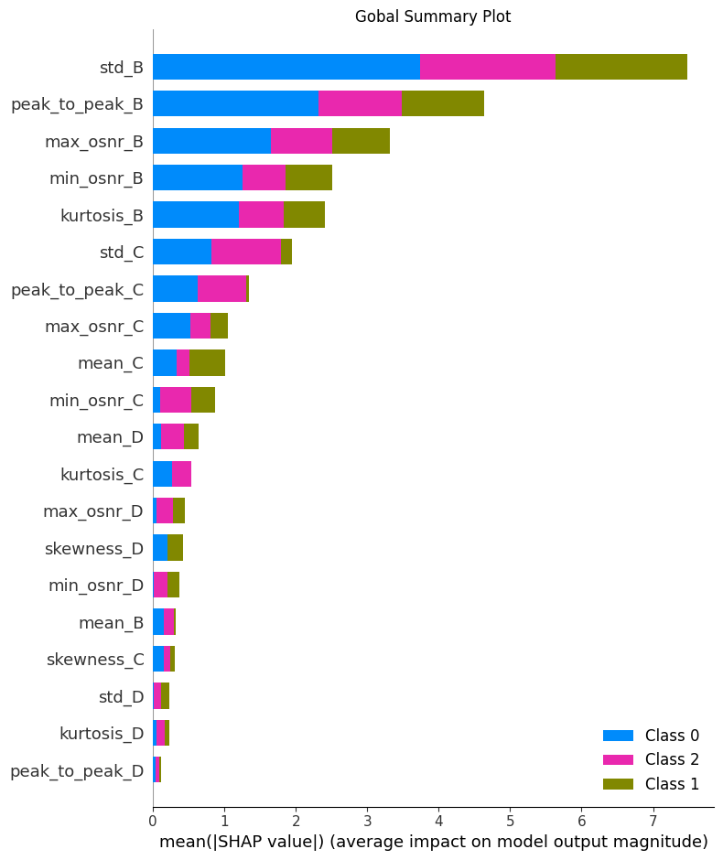
Explainable AI – Logistic Regression – Random Train
Multiple Monitoring | Window Size = 10 | Space = 1

Slide 19
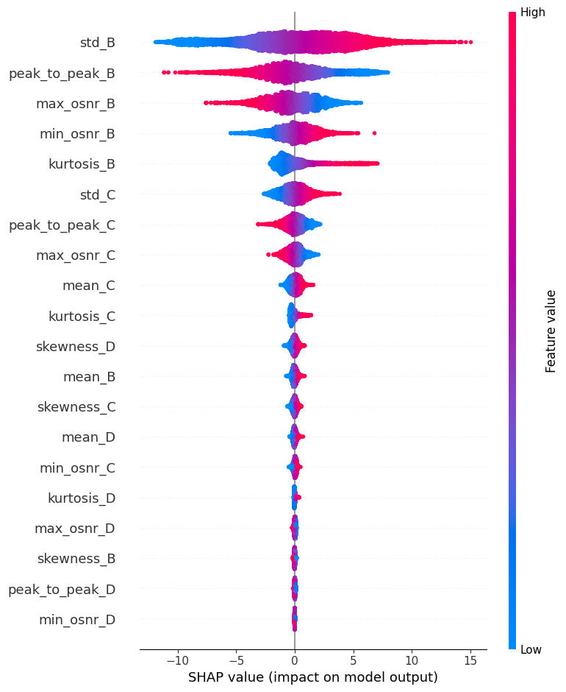
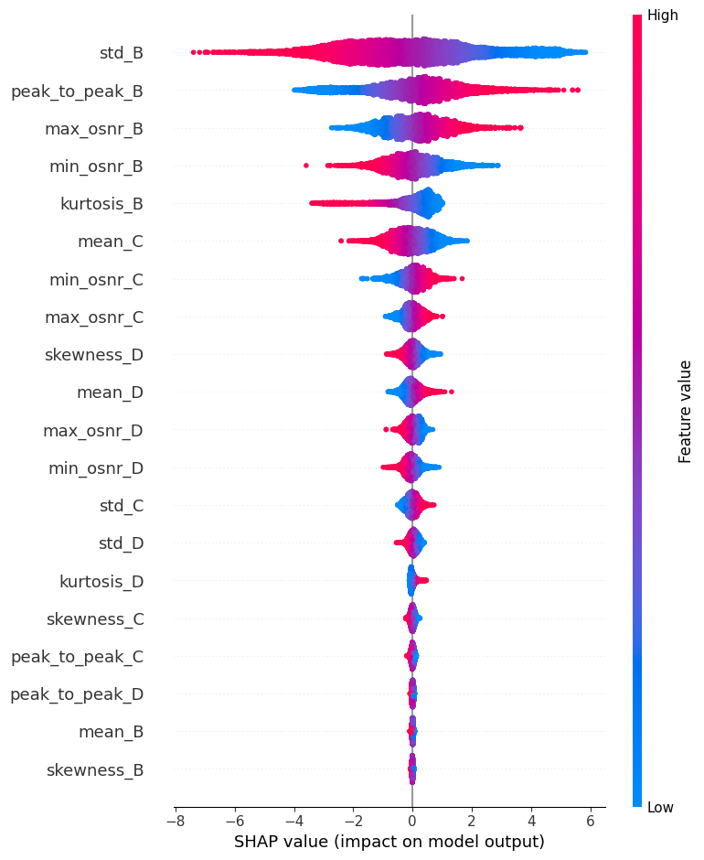
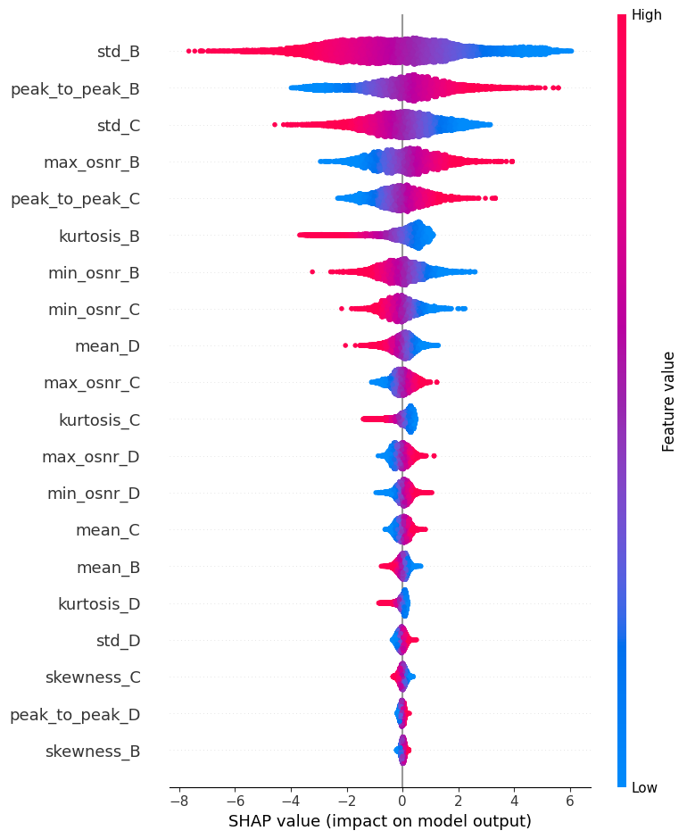
Multiple Monitoring | Window Size = 10 | Space = 1
Link 1
Link 2
Link 3

Slide 20
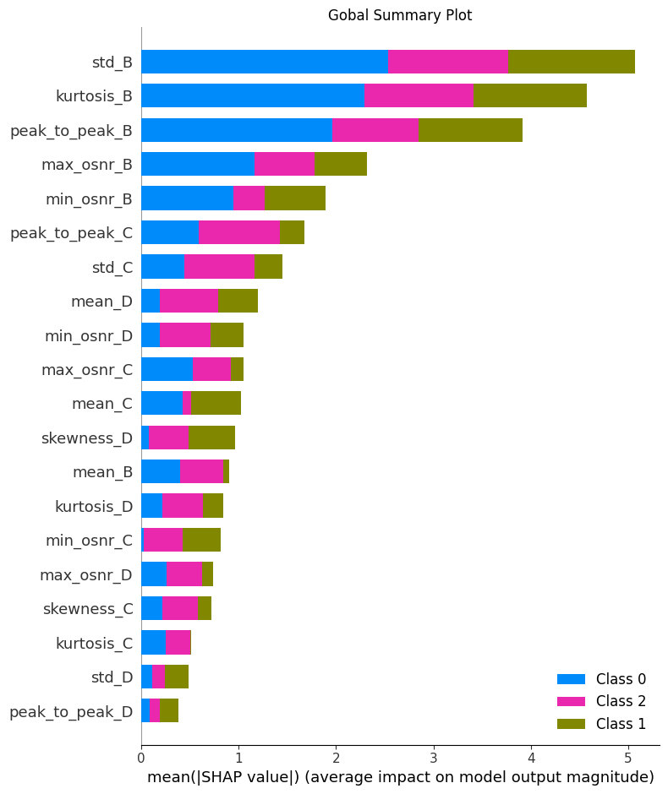
Explainable AI – Logistic Regression – Random Train Multiple Monitoring | Window Size = 100 | Space = 25

Slide 21
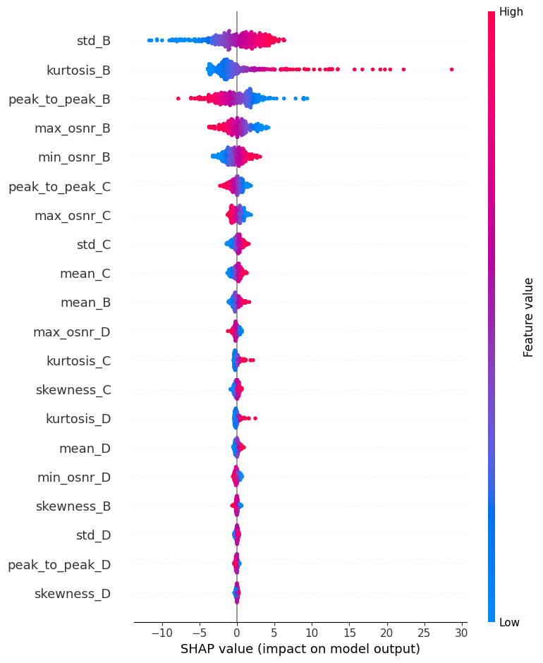
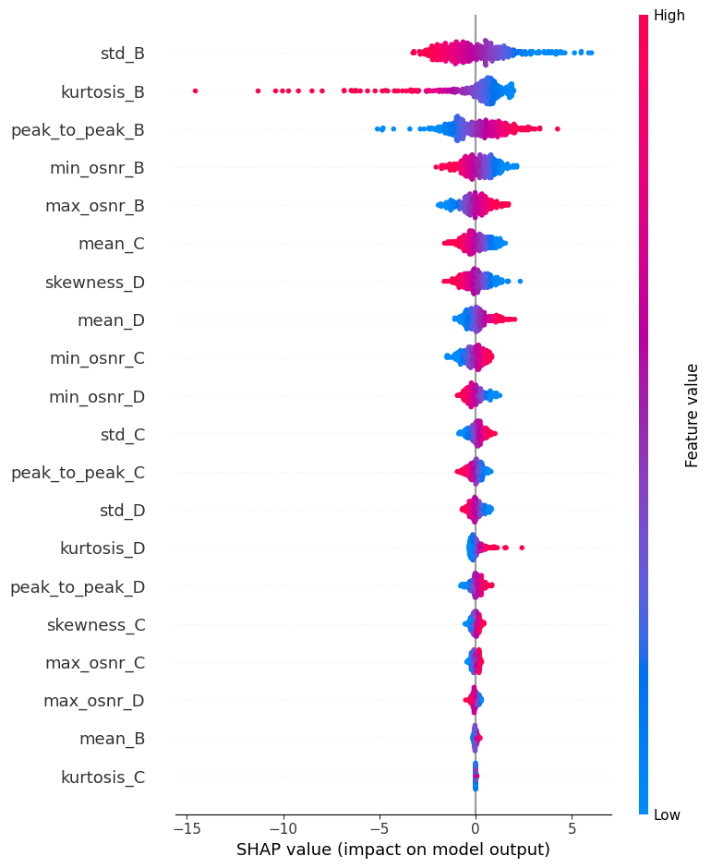
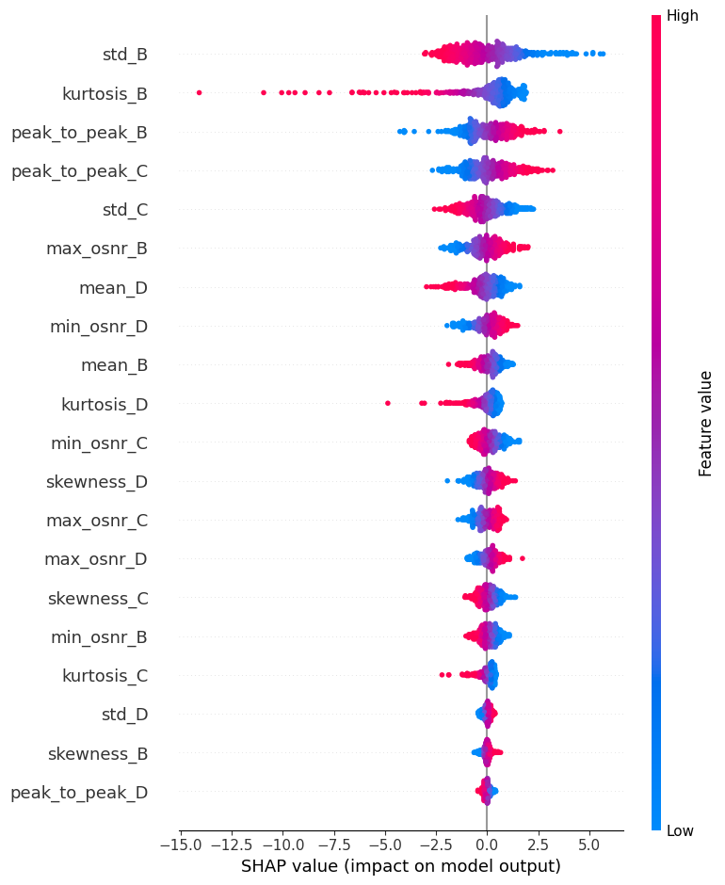
Multiple Monitoring | Window Size = 100 | Space = 25
Link 1 Link 2 Link3

Slide 22
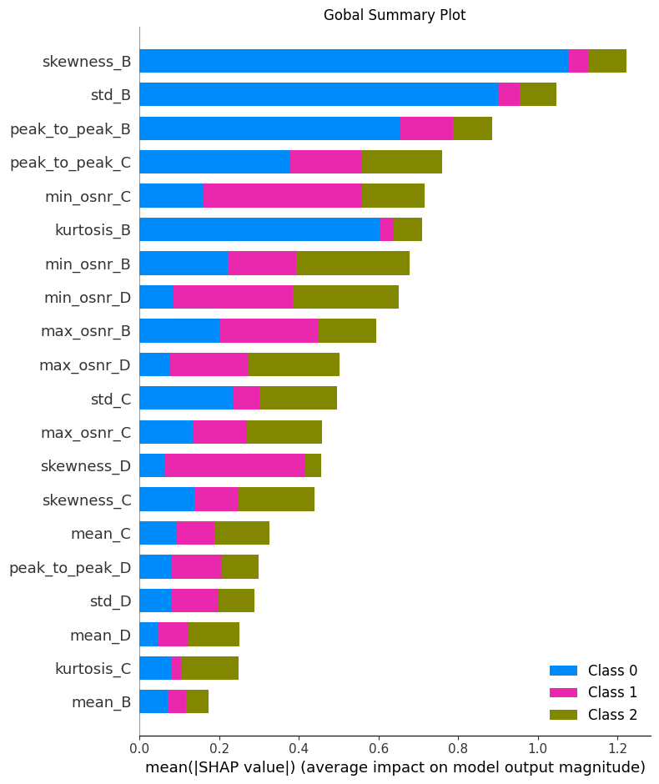
Explainable AI – XGBoost – Random Train Multiple Monitoring | Window Size = 10 | Space = 1

Slide 23
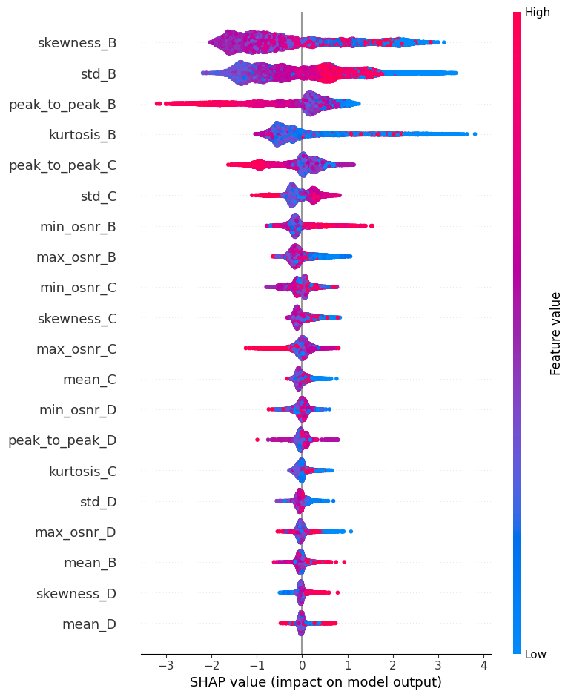
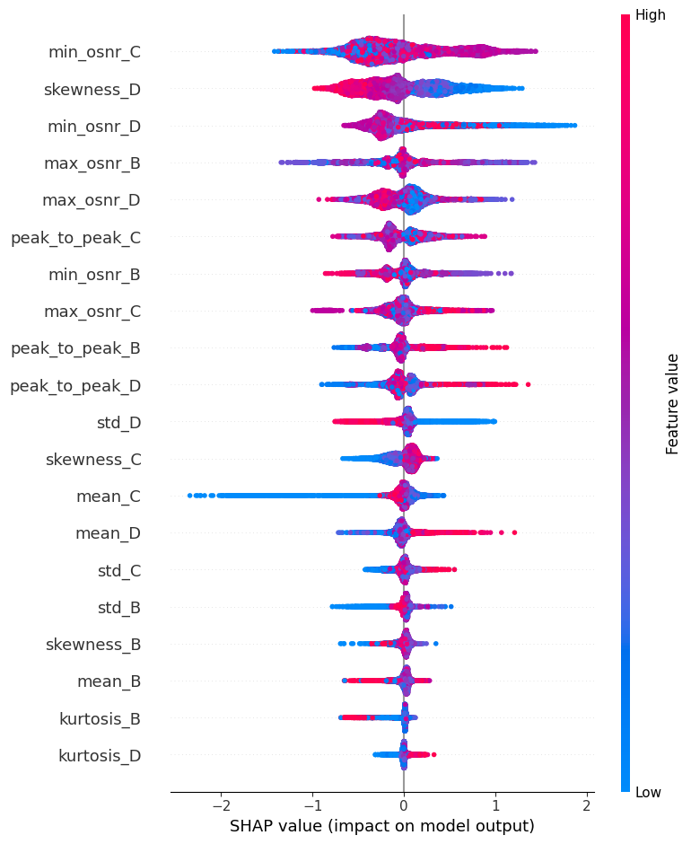
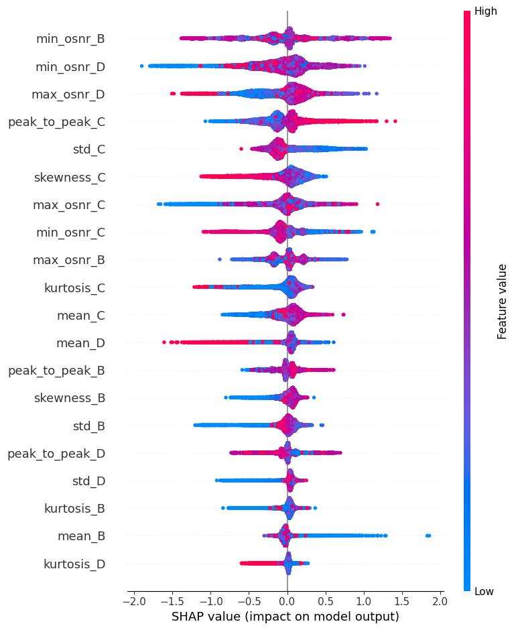
Multiple Monitoring | Window Size = 10 | Space = 1
Link 1 Link 2 Link3

Slide 24
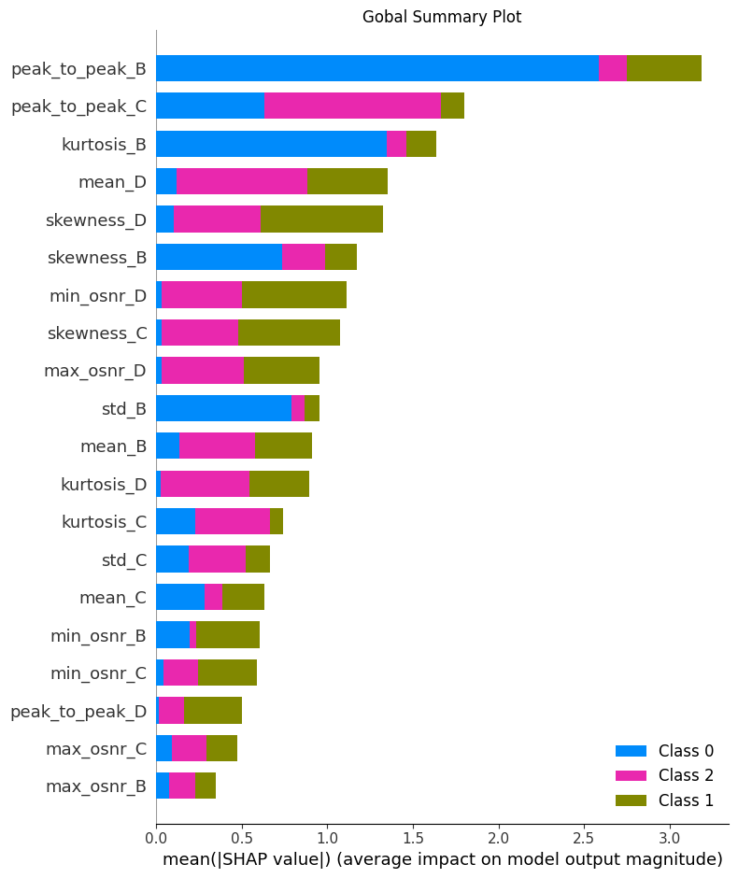
Explainable AI – XGBoost – Random Train Multiple Monitoring | Window Size = 100 | Space = 25

Slide 25
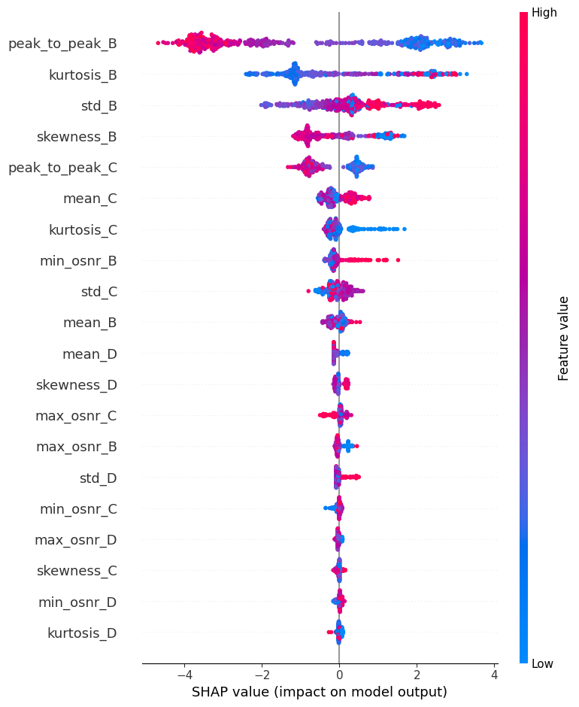
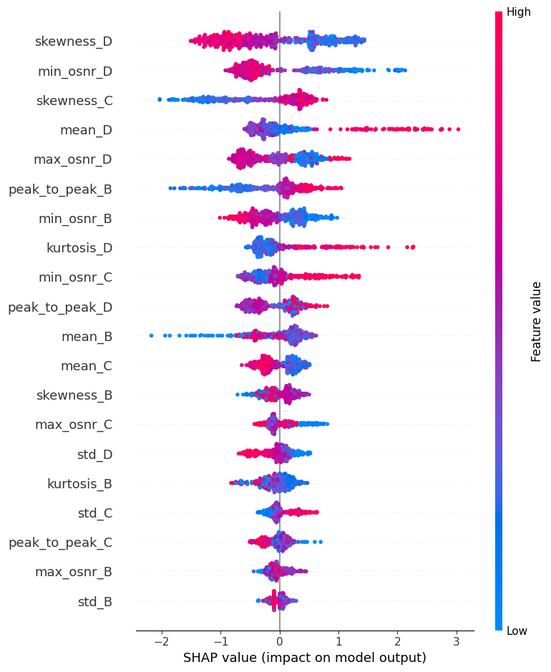
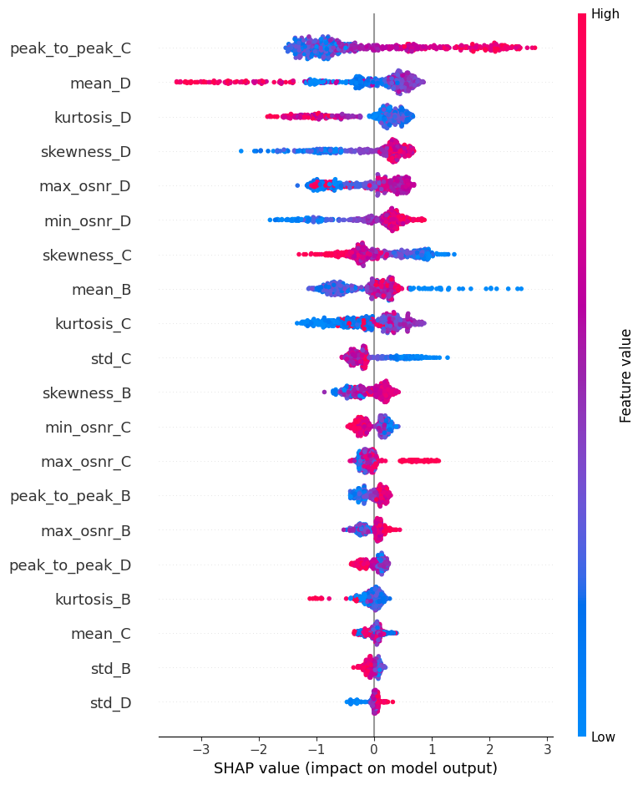
Multiple Monitoring | Window Size = 100 | Space = 25
Link 1 Link 2 Link3
*Due to the poor results compared with XGBoost and Regression and slide limitation we do not consider LSTM model.

Slide 26
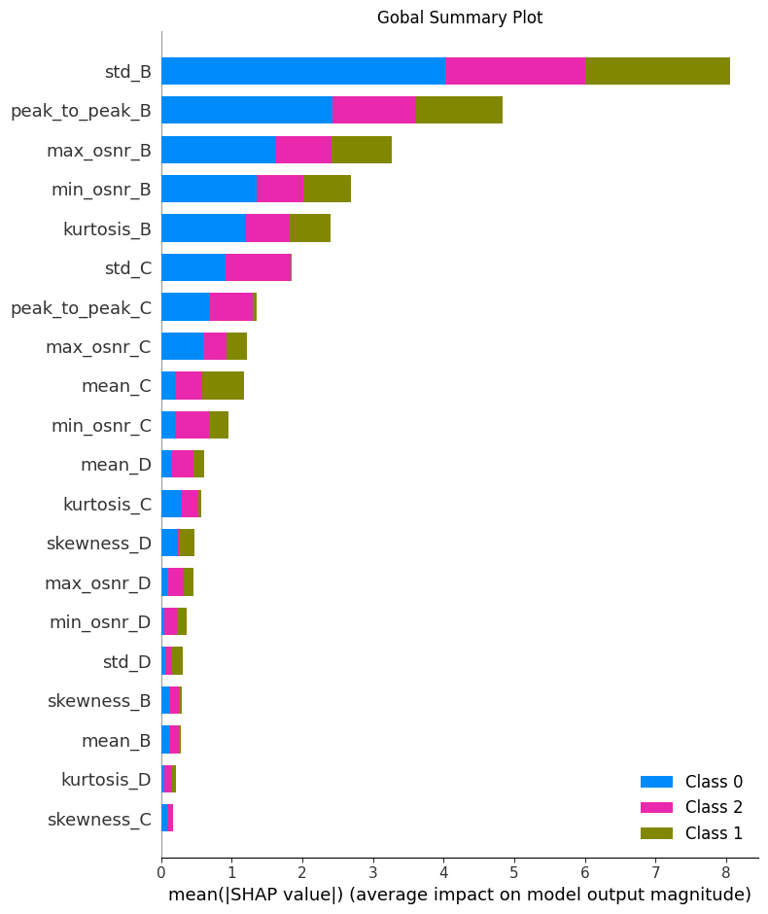
Explainable AI – Linear Regression – In time Train & Test Splits Multiple Monitoring | Window Size = 10 | Space = 1

Slide 27
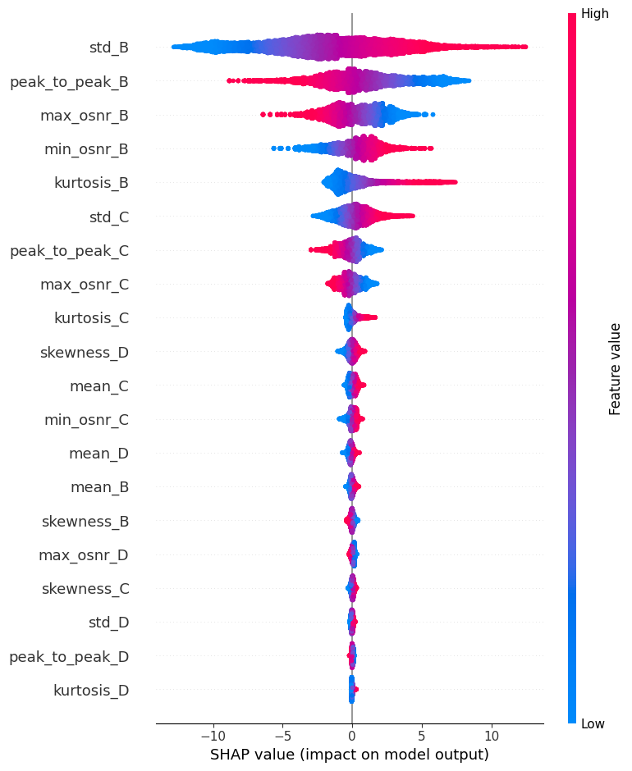
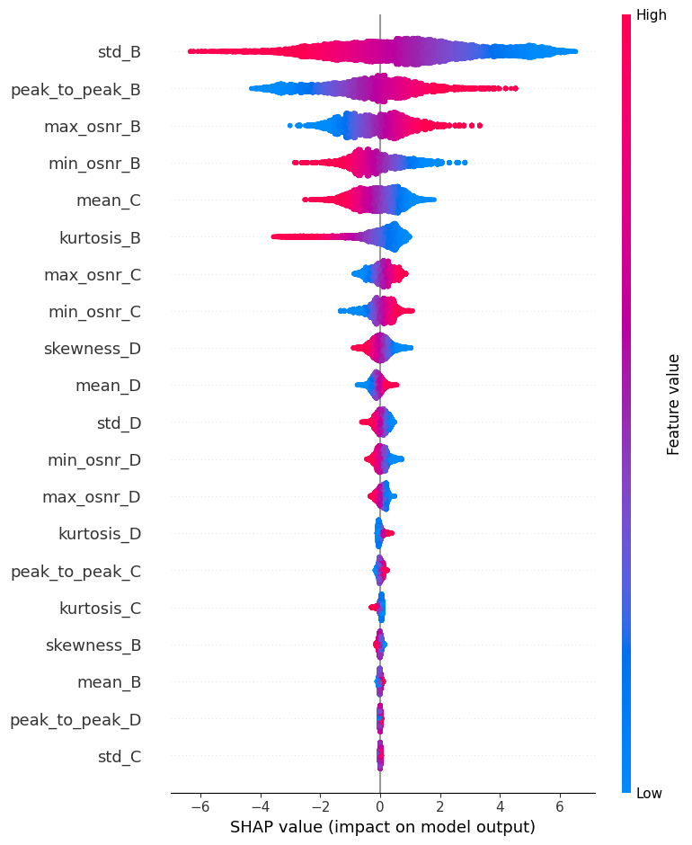
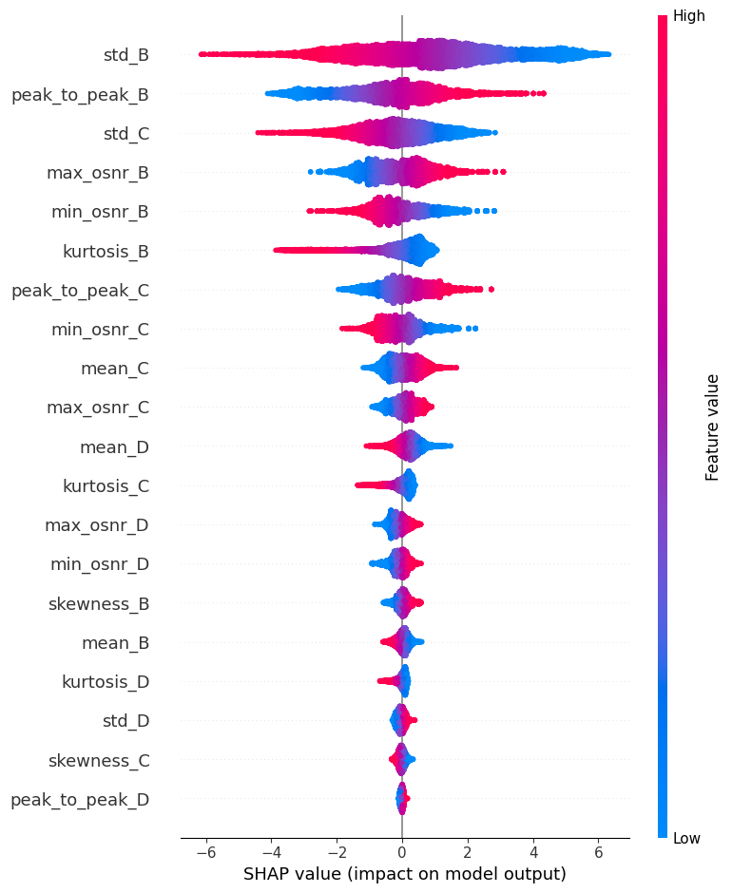
Multiple Monitoring | Window Size = 10 | Space = 1
Link 1 Link 2 Link3

Slide 28
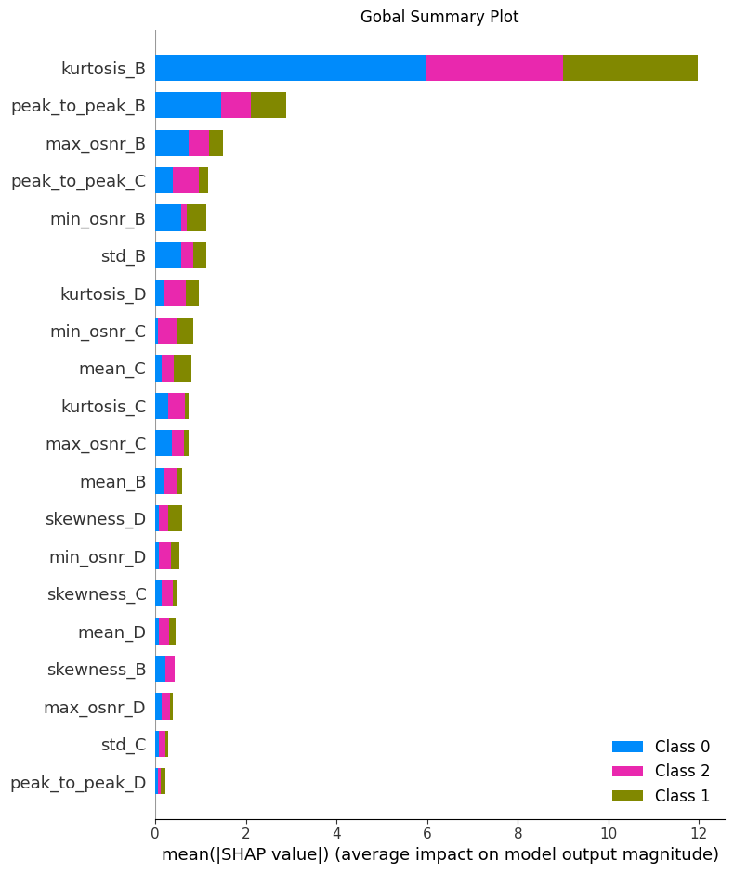
Explainable AI – Linear Regression – In time Train & Test Splits Multiple Monitoring | Window Size = 100 | Space = 25

Slide 29
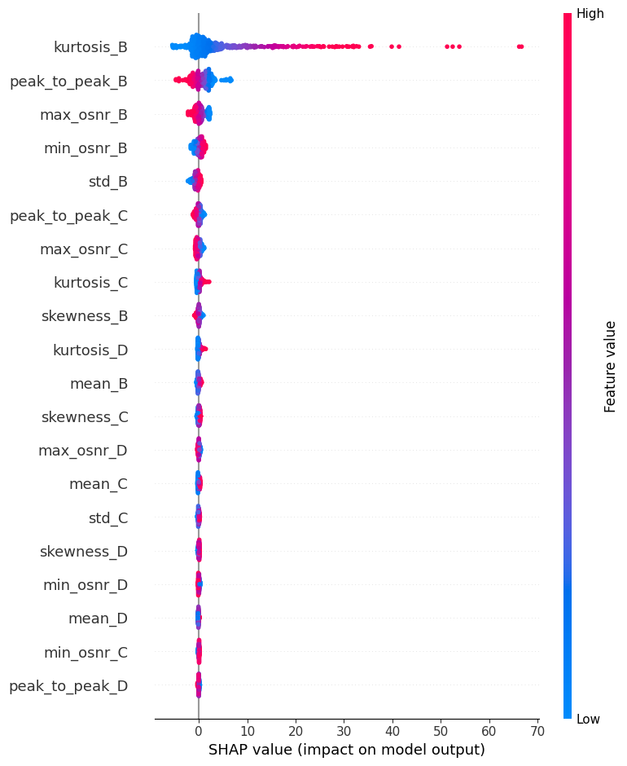
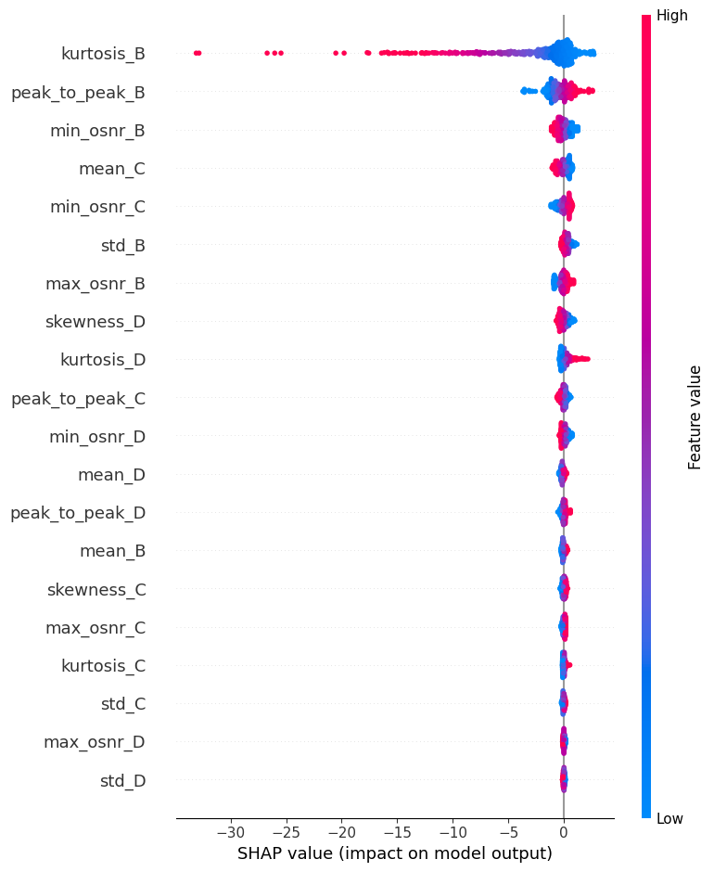
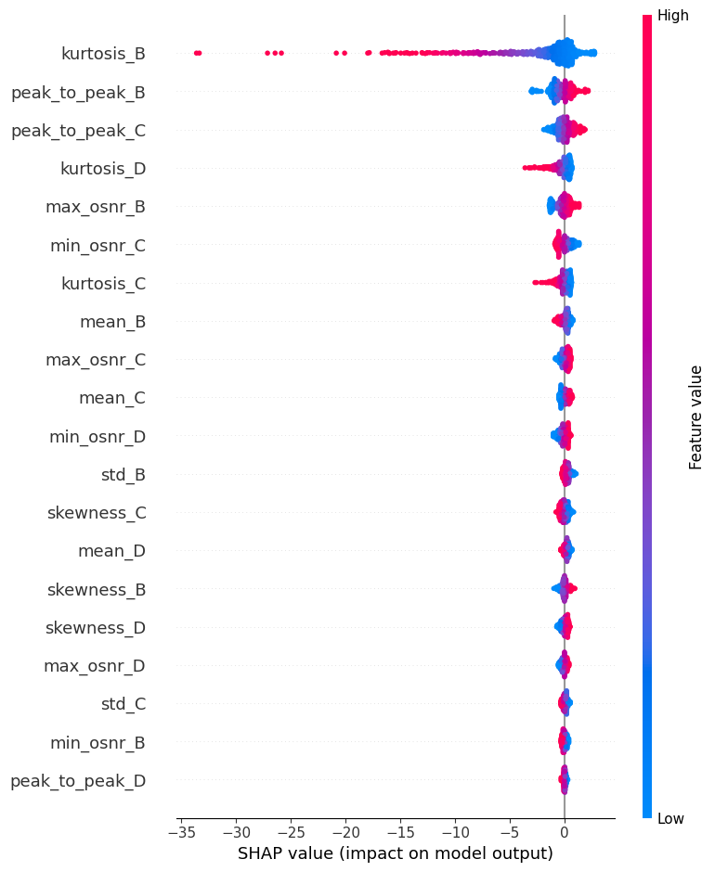
Multiple Monitoring | Window Size = 100 | Space = 25
Link 1 Link 2 Link3

Slide 30
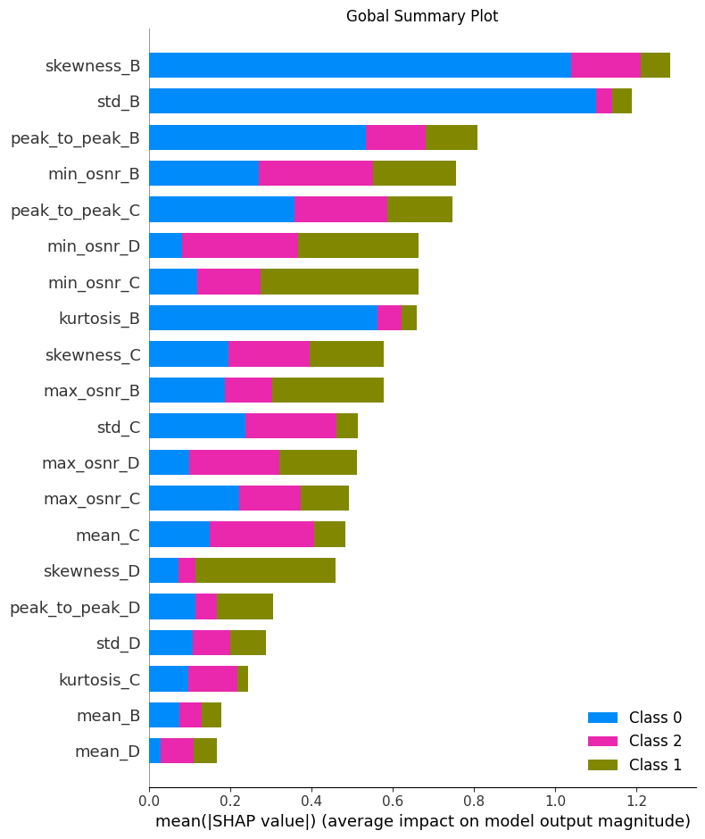
Explainable AI – XGBoost– In time Train & Test Splits Multiple Monitoring | Window Size = 10 | Space = 1

Slide 31
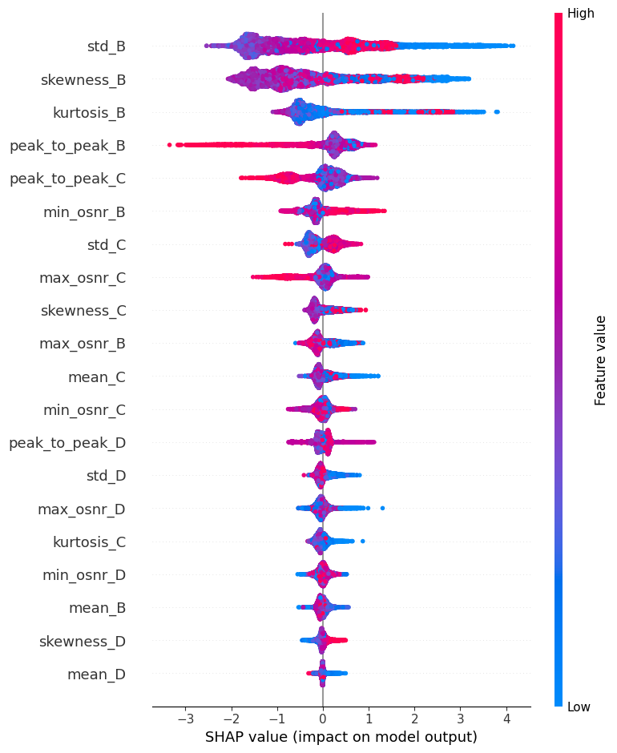
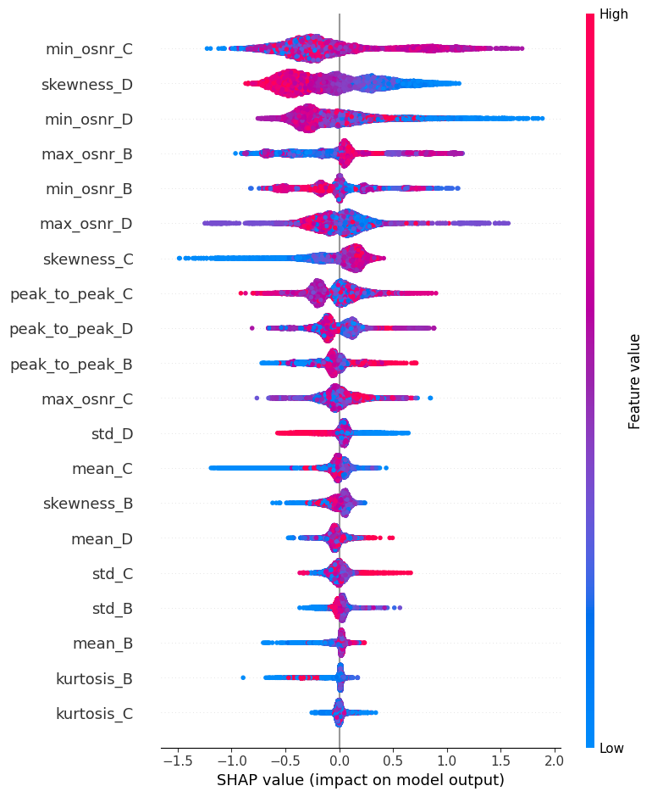
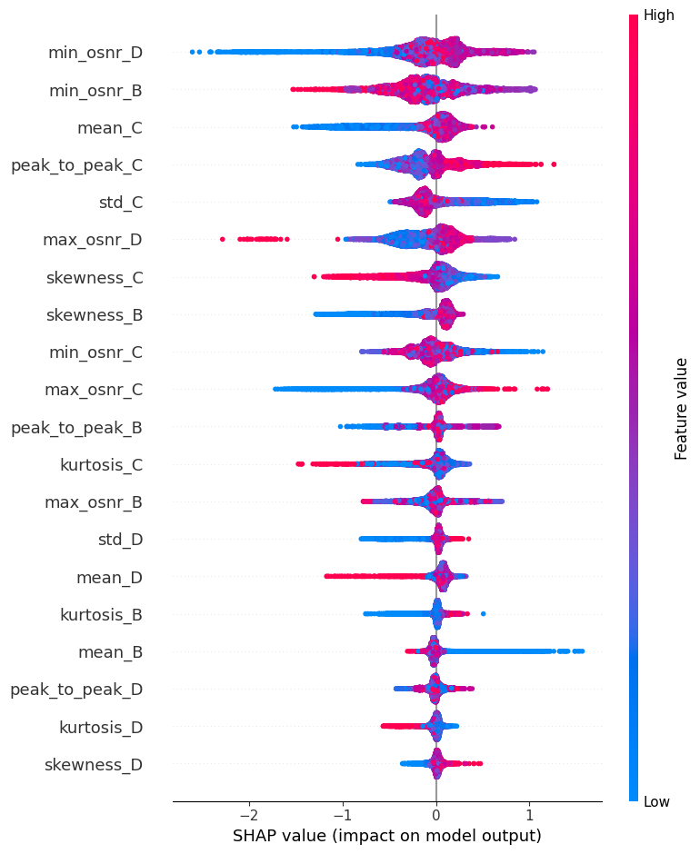
Multiple Monitoring | Window Size = 10 | Space = 1
Link 1 Link 2 Link3

Slide 32
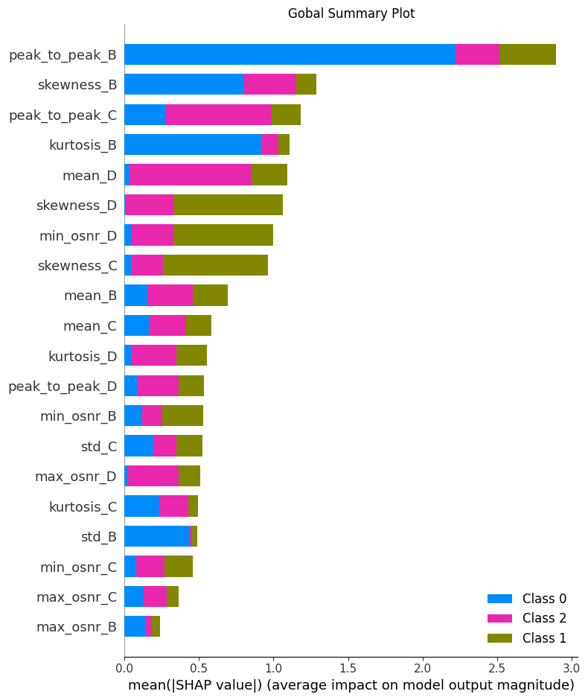
Explainable AI – XGBoost– In time Train & Test Splits Multiple Monitoring | Window Size = 100 | Space = 25

Slide 33
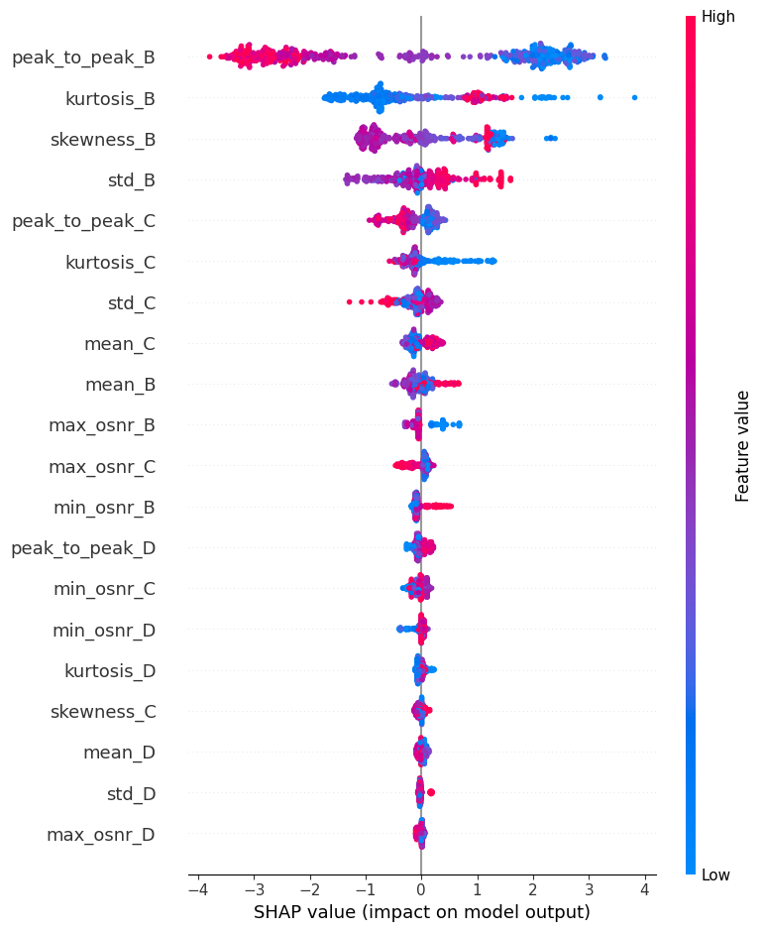
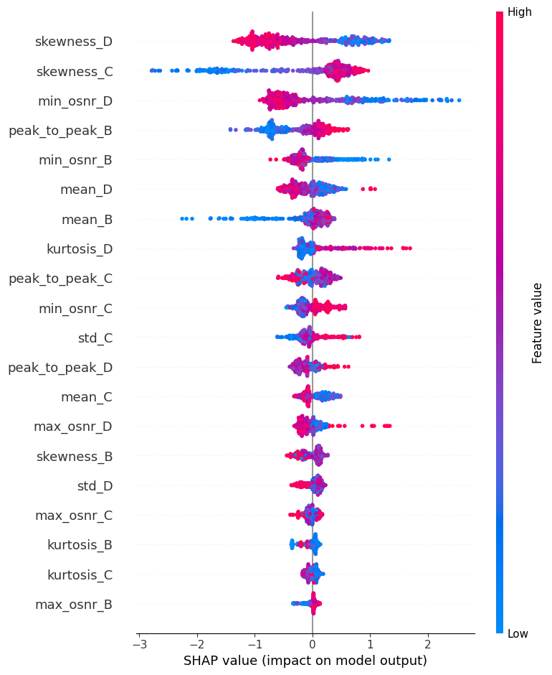
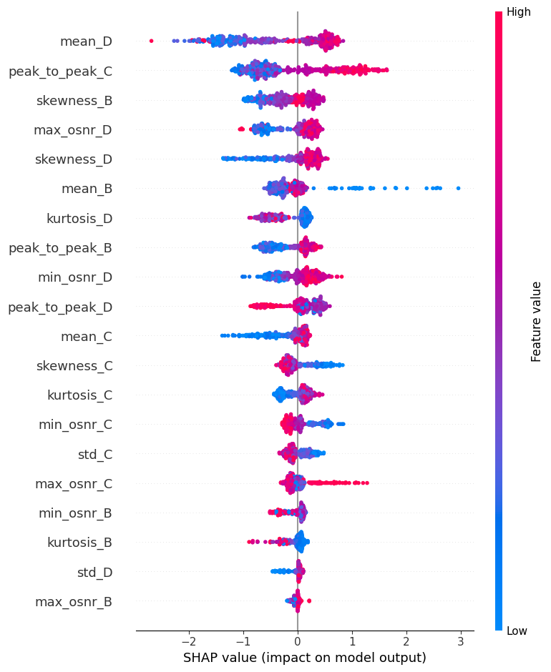
Multiple Monitoring | Window Size = 100 | Space = 25
Link 1 Link 2 Link3

Slide 34
*XGBoost plays a vital role in this project and we discuss its result in the following slides
Explainable AI – XGBoost Multiple Monitoring | Window Size = 10 | Space = 1
We observed that our model primarily used the statistical features of link 1 to classify faults at link 1
The SHAP values for in-time splitting and random splitting were very similar.
For classifying link 3, the model seems to rely mostly on the reverse features of link 2, specifically the standard deviation and peak-to-peak values.
Explainable AI – XGBoost Multiple Monitoring | Window Size = 100 | Space = 10
The use of larger windows produces features that make more logical sense.
For link 3 classification, the model largely relies on features from link 2 along with its own features.
For link 2 classification, it appears the model is not using features from link 2, but rather selecting features that are neither from link 1 nor link 3.

Slide 35
Conclusion
XGBoost is the best choice if performance is the most important factor.
Following Explainable AI analysis, we found that larger windows with greater spacing are more logical
We observed that randomly splitting the train and test sets results in better performance.
Utilizing the full dataset, rather than a partial dataset limited to monitoring data, yields better performance.

Slide 36

Thank you for your consideration
Any questions?!

Slide 37
Backup slides
What is Logistic Regression?
Logistic regression is a classification technique.
There are 3 types of logistic regression:
1- Binomial
2- Multinomial
3- Ordinal

Slide 38
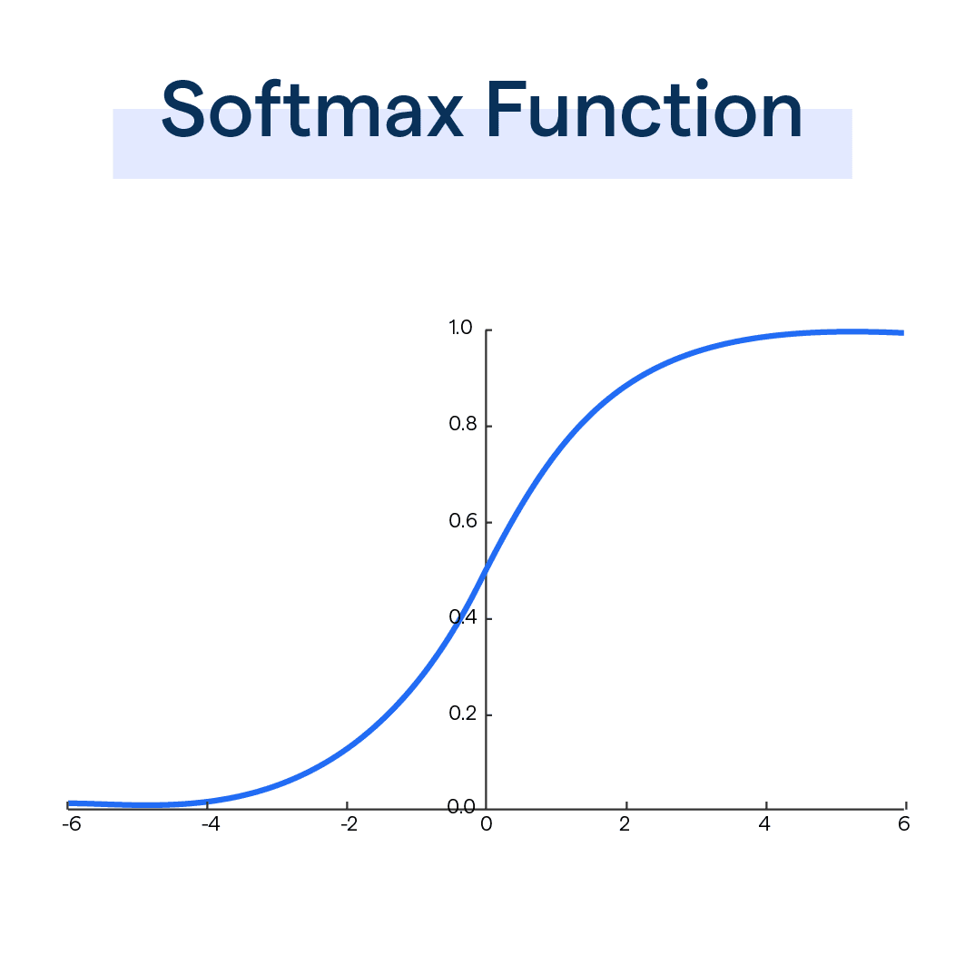
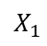
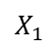
Logistic regression for multiple classes
Multinomial Logistic Regression:
Softmax Function: converts a vector of K real numbers into a probability distribution of K possible outcomes. It is a generalization of the logistic function to multiple dimensions, and used in multinomial logistic regression.
Cross-Entropy Loss: Measure the model performance
$$X_{1}$$
$$X_{2}$$
One vs all
$$X_{1}$$
$$X_{1}$$
$$X_{1}$$
$$X_{2}$$
$$X_{2}$$
$$X_{2}$$

Slide 39

What is XGBoost?
XGBoost, which stands for Extreme Gradient Boosting, is a scalable, distributed gradient-boosted decision tree (GBDT) machine learning.
It is a combination of supervised machine learning, decision tree, ensemble learning and gradient boosting.

Slide 40
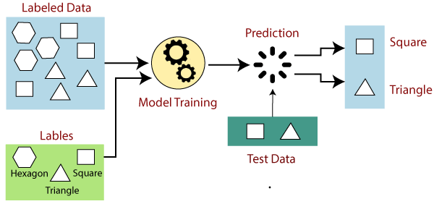
Supervised Learning

Slide 41
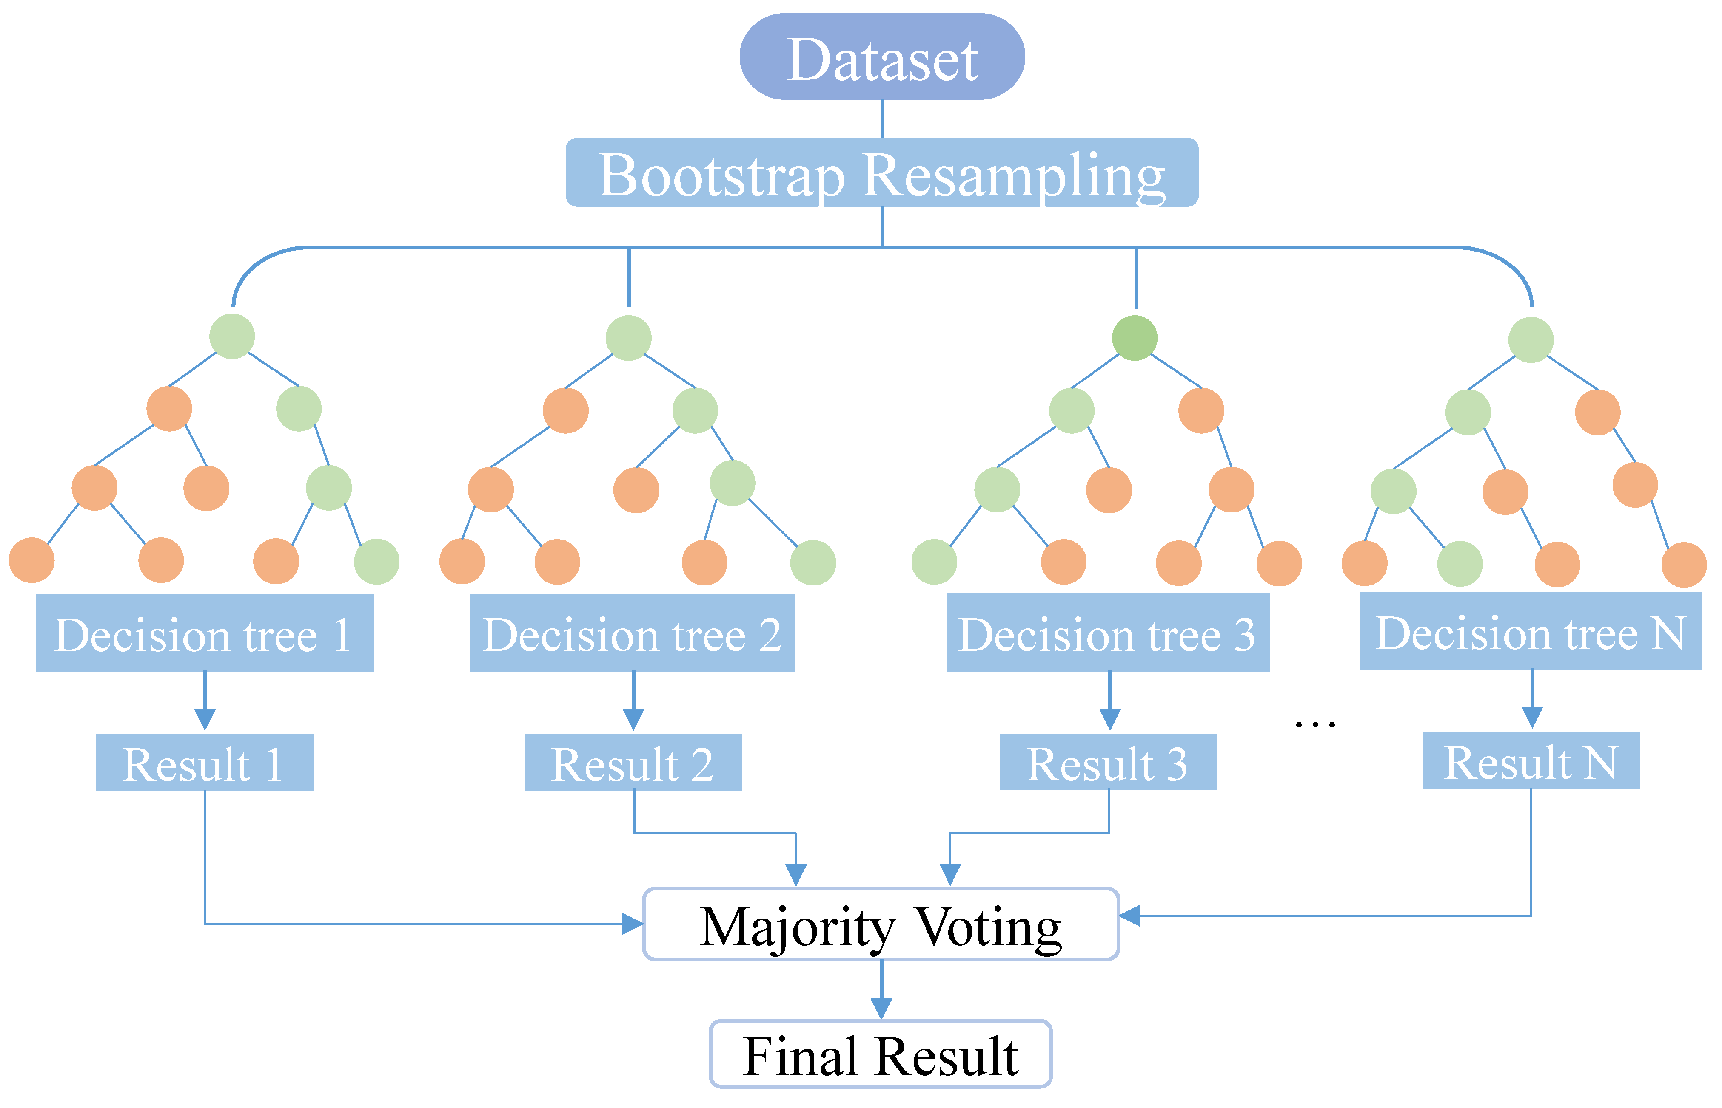
Decision Tree Ensemble Learning

Slide 42
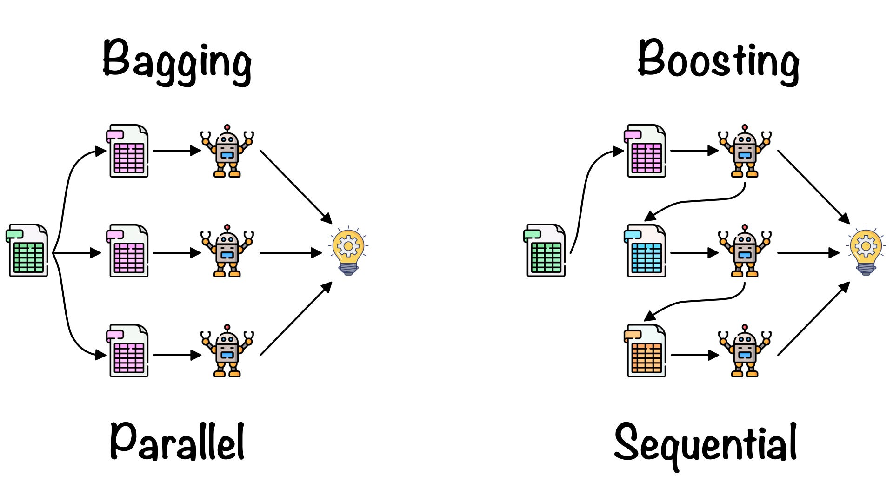
Bagging and Boosting

Slide 43
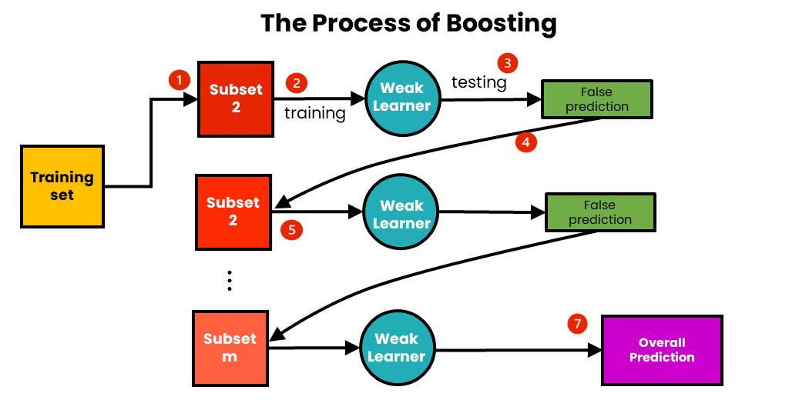
Boosting Model
ویک لرنر دوم میاد به داده هایی که خطای بیشتری داشتند وزن بیشتری اختصاص می دهد در واقع در لاس فانکشن مدل بعدی جریمه ی بیشتری به آن داده های تعلق می گیرد. در نهایت وقتی همه ی اینکار ها را انجام دادیم هر داده یک ضریبی می گیرد همچنین هر مدلی هم یک ضریبی میگیرد حالا وقتی که یک ورودی جدید میدیم این ورودی جدید وارد هرکدوم از مدلا میشن و باتوجه به ضریب هر مدل خروجی رو خواهیم داشت بوستینگ از بگینگ بیشتر استفاده میشه و بهتره نتیجش اما پردازششم کند تره
To avoid the overfitting and bad pressure for the processor we use weak model such as decision tree

Slide 44
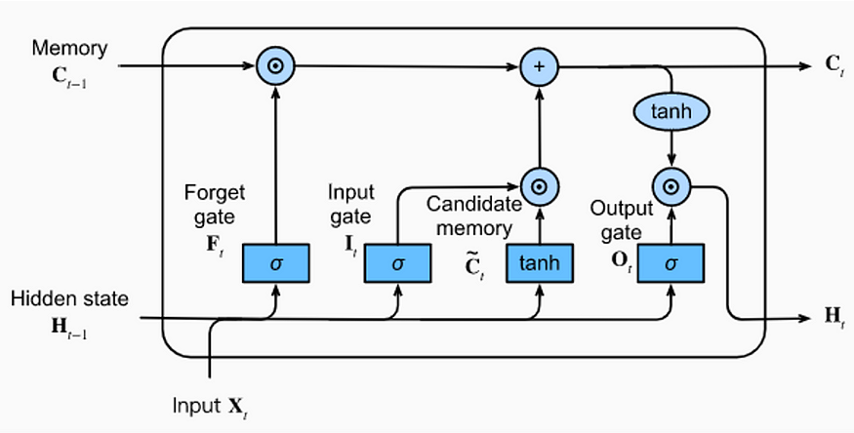
LSTM(Long Short – Term Memory)

